Slide 1

Evaluation of Quantitative Polymerase Chain Reaction (qPCR) as a Procedure for Monitoring Bacteria on the Texas Coast
Jeff Brady, Ph.D.
Assistant Professor
Department of Soil and Crop Sciences
Texas A&M AgriLife Research and Extension Center Stephenville, TX

Slide 2
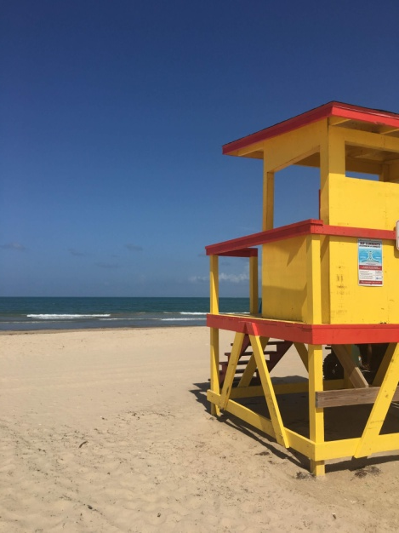
Study Objective
To determine the applicability of EPA Method 1609.1 for enumerating Enterococcus bacteria in waters collected at recreational beaches along the Texas Coast
IDEXX vs qPCR detection method comparison
Notes:
This slide explains the objective of the study. qPCR is considered a rapid method for bacteria enumeration. By comparison, the IDEXX method often yields results one to two days later, resulting in a an advisory for beach water quality that may not reflect the actual condition of the water.

Slide 3
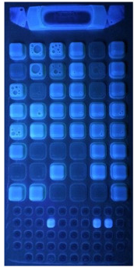
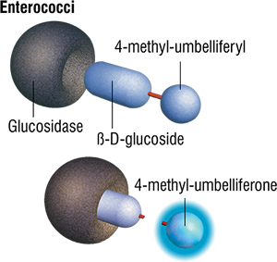
Culture-based methods (IDEXX Enterolert):
Selective media to enrich Enterococcus
  Fluorescent blue color development under UV light (β-glucosidase)
18-24 hour incubation

Slide 4
Quantitative Polymerase Chain Reaction (qPCR)
Forward primer
Reverse primer
DNA Polymerase
Fluorescent Probe
Key attributes:
Cycles of heating and cooling to produce more copies of the DNA target
Thermostable enzyme
Detection by increase in fluorescence
Results in ~ 6 hrs

Slide 5
Quantitative Polymerase Chain Reaction (qPCR)
  Detect DNA targets
  Specific to species with primers and probes
  Requires DNA extraction
  Requires specialized equipment and personnel
  ~2 hour test
  Results from instrument are plugged into an EPA spreadsheet for EPA Method 1609.1 (QC/copy number adjustments)
  Susceptible to PCR inhibitors and PCR interference which may cause QC failures
Fluorescence
Cycles
Cycles
Log DNA Concentration
Notes:
To use PCR in a quantitative manner, serial dilutions of known concentrations of bacterial culture are used to generate standard curves.
In this representation, the amplification curves on the left correspond to the points on the standard curve on the right. The higher the concentration of DNA, the earlier amplification will occur.
The standard curve can then be used to calculate concentrations of unknown samples by measuring the amplification cycle of the DNA.

Slide 6
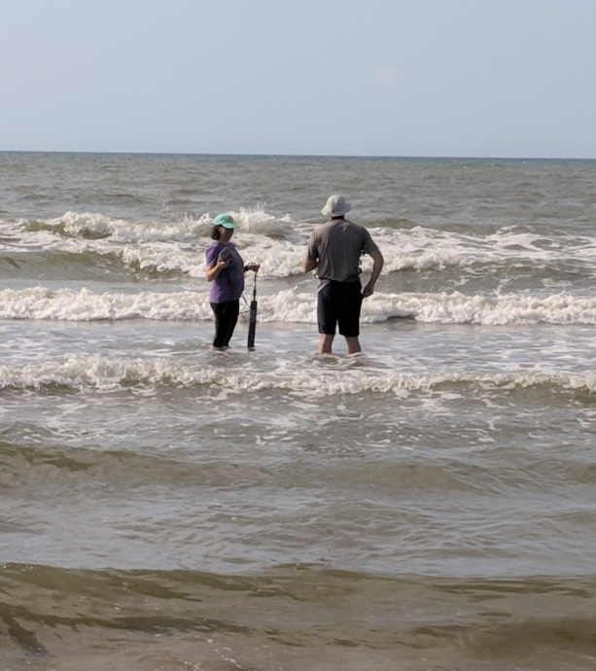
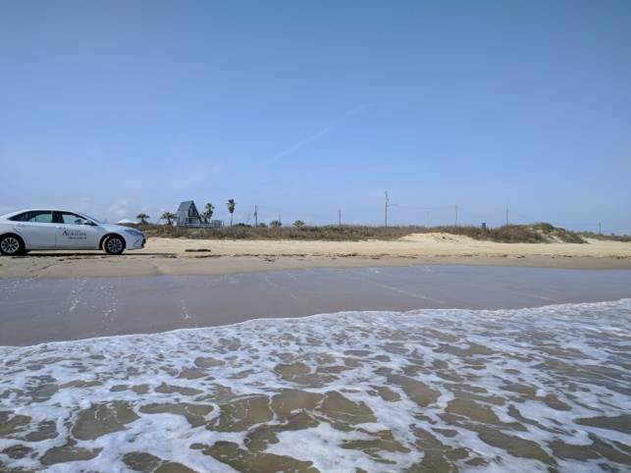
The Study
Summer of 2018
Texas coast (marine waters)
9 sites
3 different collection events at each site (Spanning July-Sept.)
Notes:
The study was conducted along the Texas coast in the summer of 2018. Nine sites were visited three times each between July and September.

Slide 7
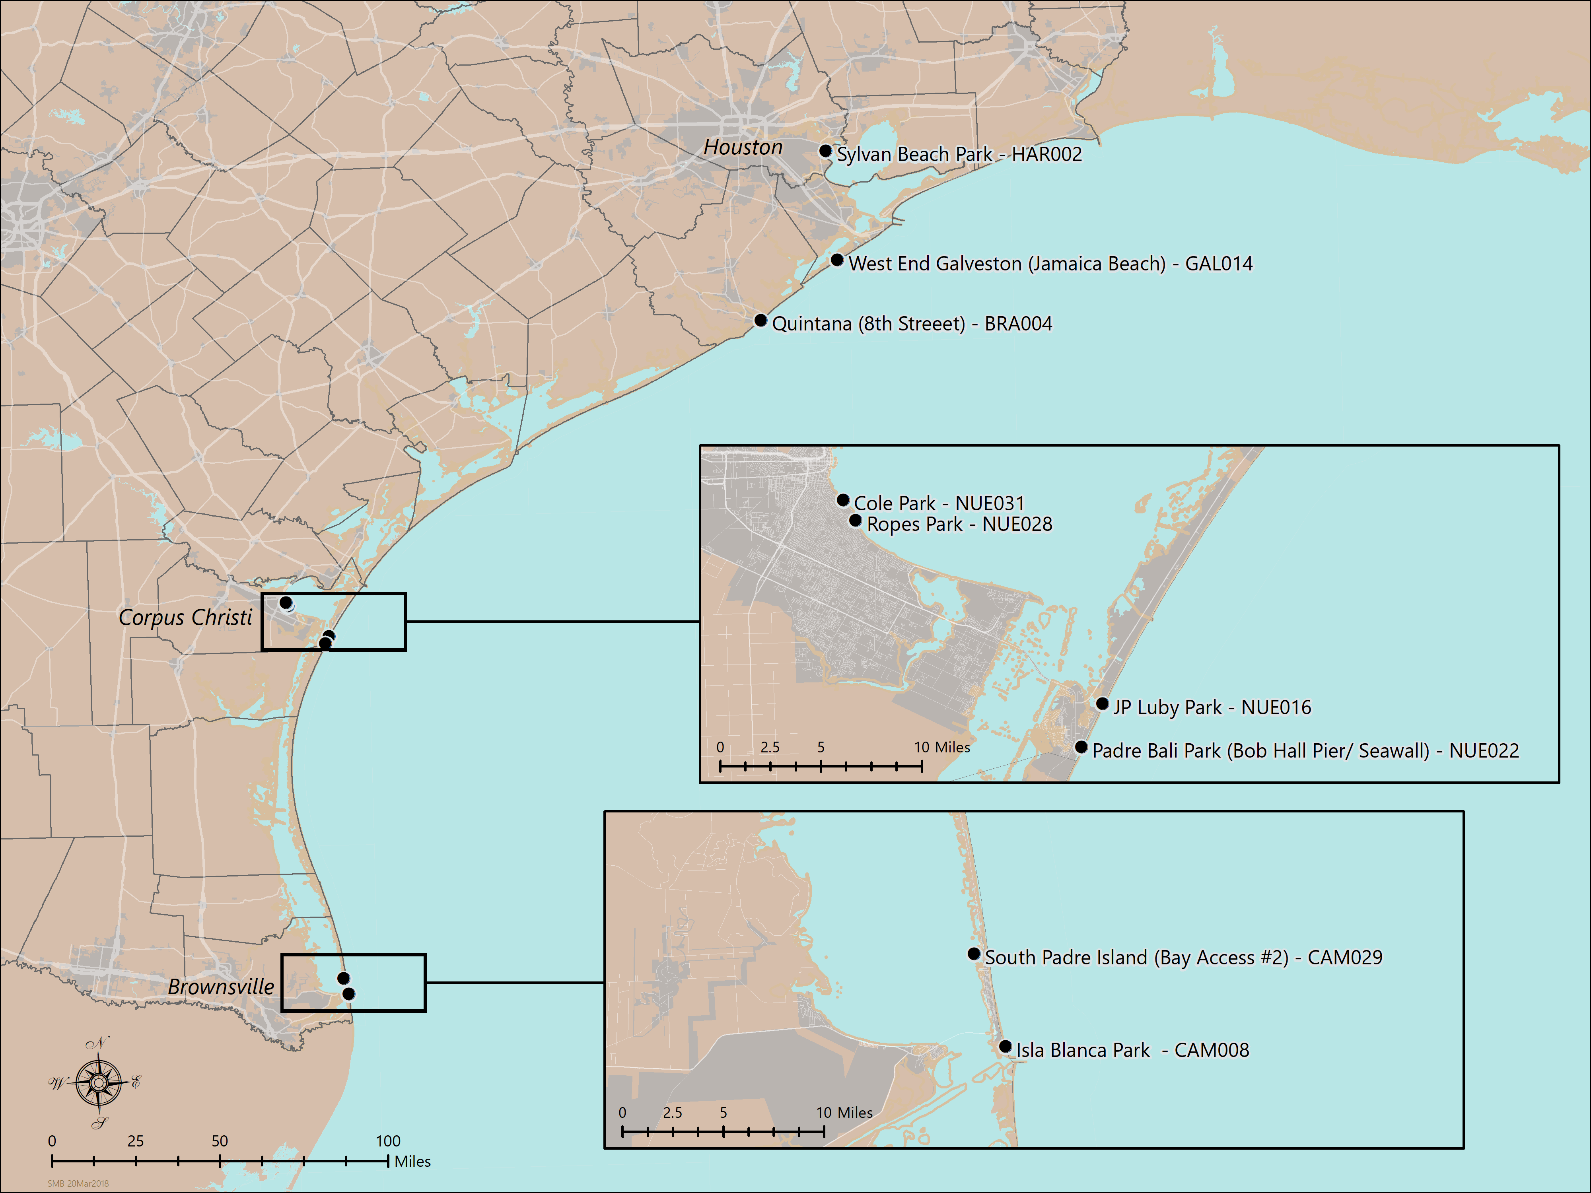
Map of the Sampling Locations
Sites:
Sylvan Beach Park – HAR002
Jamaica Beach – GAL014
Quintana – BRA004
Cole Park – NUE031
Ropes Park – NUE028
Luby Park – NUE016
Padre Bali Park – NUE022
South Padre Island – CAM029
Isla Blanca Park – CAM008
Notes:
Here is a map of the 9 sampling locations. Locations were along the length of the Texas Gulf Coast, and site names are listed along the side of the map for clarity.
3 sites were located in the Galveston/Houston area, 4 in the Corpus Christi area, and 2 in the South Padre area.
Further, Galveston/Houston had 1 bayside and 2 oceanside sites, Corpus Christi had 2 bayside and 2 oceanside, and South Padre had 1 bayside and 1 oceanside.
Arrows indicate two important sites to note: BRA004 (oceanside Galveston area)
and NUE031 (bayside Corpus Christi area) were sites where PCR interference was primarily observed, most extremely during one sampling event, 7/31/2018 for BRA004 and 8/1/2018 for NUE031.

Slide 8
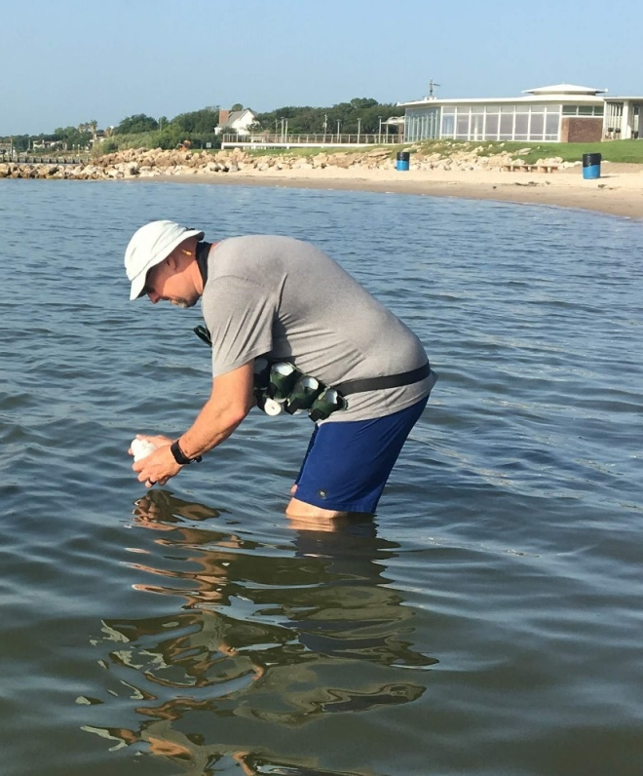

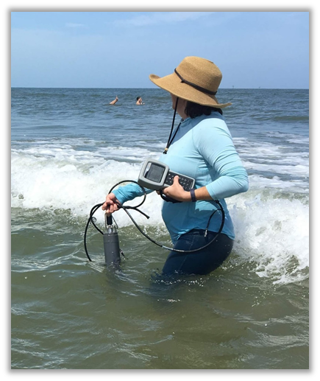
Sample Collection
Notes:
Sample collection will be described following this slide. Photos of researchers collecting samples.

Slide 9
Sample Design
Sample Collection Method 1
>1 minute
~15 meters
>1 minute
~ 15 meters
>1 minute
~15 meters
>1 minute
~15 meters
>1 minute
~15 meters
2 L
250 mL
250 mL
250 mL
250 mL
250 mL
Sample depth = 0.15 m
Water depth = 0.5 m
<=50 m from shoreline
1-5 qPCR
6
7
8
9
10
qPCR
250 mL
250 mL
qPCR
250 mL
250 mL
250 mL
1-5 IDEXX
6
qPCR
7
8
qPCR
9
qPCR
10
IDEXX
IDEXX
IDEXX
IDEXX
IDEXX
Sample Collection Method 2
9 Sites
3 Sampling events per site
20 Samples per site per event
  10 qPCR, 10 IDEXX
Total Samples = 540
S h o r e l i n e
Water
Beach
Notes:
The study was conducted along the Texas coast in the summer of 2018. Nine sites were visited three times each between July and September. Samples were collected 50 meters from the shoreline at a depth of 0.15 m. For sample collection method one, a 2 liter volume was collected and then split in half for qPCR and IDEXX in five separate samples to compare variation in a bulk-collected sample vs. 5 independently-collected samples. For sample collection method two, 5 independent samples were collected for each of the two methods (IDEXX and qPCR) in separate collection bottles. Spoiler: the Enterococcus numbers were more variable in the bulk-collected samples than in independently-collected samples. As a result, for the statistical tests, one randomly selected rep from the bulk-collected sample was combined with the independently-collected samples so that each for each site/event combination, there were 6 independent experimental reps.

Slide 10
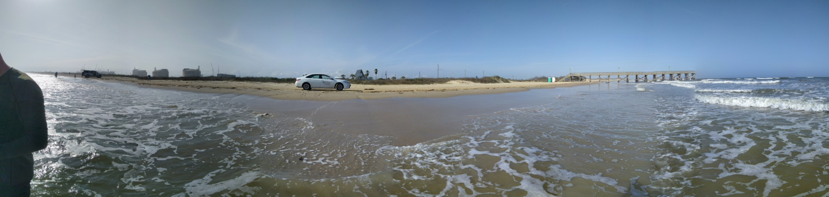
Sampling and Handling Procedures for Bacteria Samples
Parameter | Container | Field Preservation | Sample Volume* | Holding Time | Laboratory
Enterococcus bacteria by Standard Methods 9223B for IDEXX Enterolert analysis | Sterile plastic | Sodium thiosulfate, cool to >0 to <6°C | 100 mL | 6+2 hours | TIAER
Enterococcus bacteria by EPA Method 1609.1 by Taqman for qPCR analysis | Sterile plastic | Sodium thiosulfate, cool to >0 to <10°C; filter within 6 hours | 100 mL | Filtered within 6 hours; frozen at 20°C up to 7 days or -80°C for up to one year | AgriLife
Notes:
Enterococcus samples for IDEXX analysis were held in a sterile plastic container. They were preserved in the field with cool sodium thiosulfate-containing sample bottles. A 100mL volume sample was held for a maximum of six plus 2 hours by the Texas Institute for Applied Research Lab.
Enterococcus samples for EPA Method 1609.1 were held in a sterile plastic container and preserved in the field with cool sodium thiosulfate-containing sample bottles. The 100 mL volume samples were filtered within 6 hours and then frozen in liquid nitrogen for less than one year before being tested by qPCR. The 1609.1 Enterococcus samples were tested by Texas A&M AgriLife Research in Stephenville, TX.

Slide 11
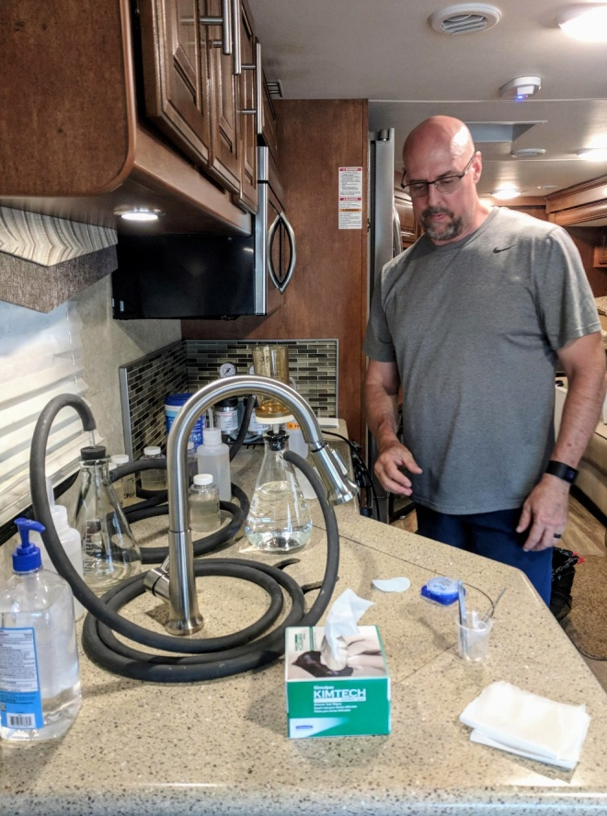
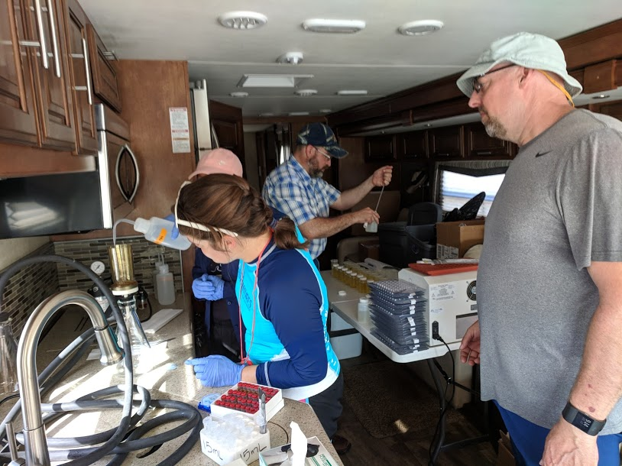
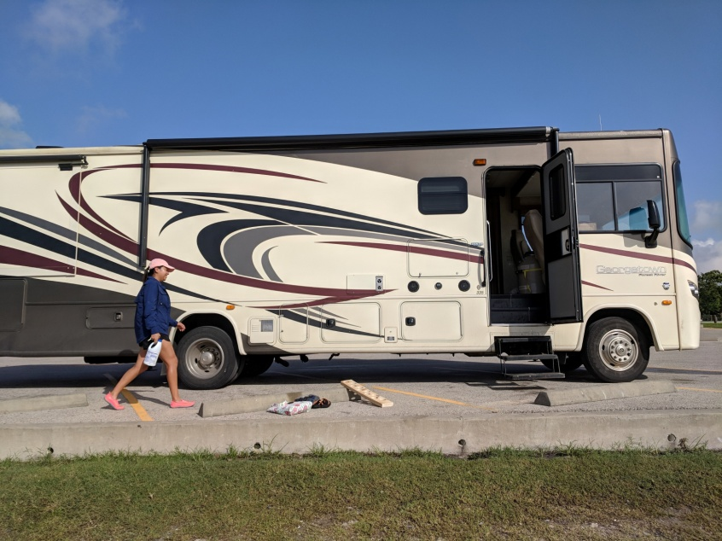
Sample processing
Notes:
Photos of sample collection and processing. Photo of the Rv Laboratory.

Slide 12
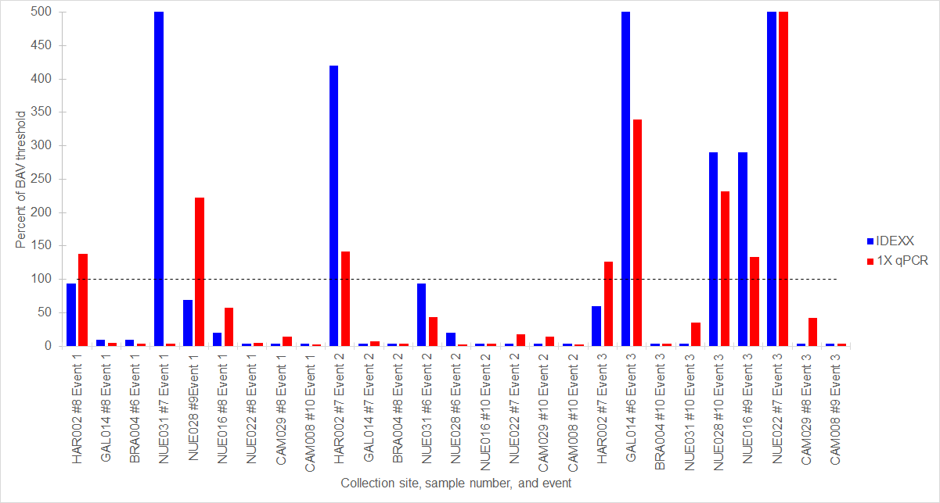
IDEXX vs. qPCR Results
Figure 9. Detection of Enterococcus in a single independent, randomly selected sample for each site-event combination by IDEXX and 1X qPCR expressed as percent of BAV threshold (104/1590 for IDEXX/qPCR). The dashed line represents the BAV threshold.
Notes:
This graph shows the IDEXX and qPCR results in relationship to percent of the Beach Action Value. The graph was created with one randomly selected sample per site/sampling event. The Beach Action Value is 104 cfu or 1590 cce. qPCR gives results in units of calibrator cell equivalents (cce) and cannot be compared directly to cfu values, so we compared based on percent of BAV threshold. The horizontal dashed line represents the BAV threshold. IDEXX is represented with blue bars, 1x dilution QPCR results are represented with red bars. The x-axis shows collection site, sample number and event. The y-axis shows the percent of BAV threshold. Texas General Land Office monitors recreational beaches on the Texas coast and when an exceedance of the BAV is detected, a swimming advisory is posted.

Slide 13
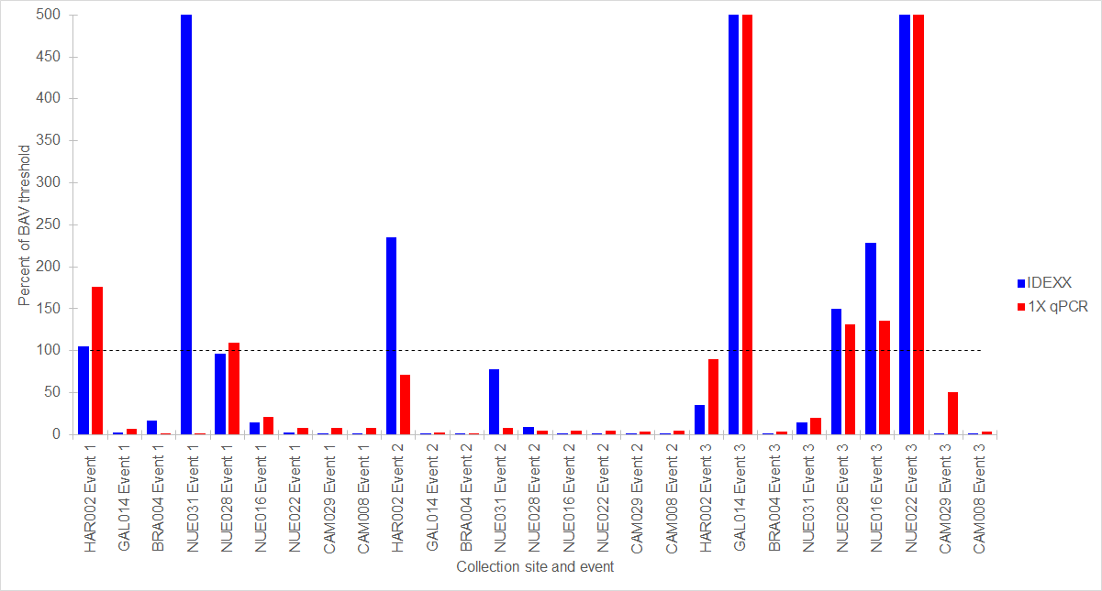
IDEXX vs. qPCR Results
Figure 11. Percent of BAV threshold for each site-event combination by IDEXX and 1X qPCR (104 IDEXX/1590 qPCR). Bars represent geometric means of 6 independently collected samples. The dashed line represents the BAV threshold.
Notes:
This graph shows the IDEXX and qPCR results in relationship to percent of the Beach Action Value. The graph was created using geometric means of each site/sampling event. The Beach Action Value is 104 cfu or 1590 cce. qPCR gives results in units of calibrator cell equivalents (cce) and cannot be compared directly to cfu values, so we compared based on percent of BAV threshold. The horizontal dashed line represents the BAV threshold. IDEXX is represented with blue bars, 1x dilution QPCR results are represented with red bars. The x-axis shows collection site, sample number and event. The y-axis shows the percent of BAV threshold. Texas General Land Office monitors recreational beaches on the Texas coast and when an exceedance of the BAV is detected, a swimming advisory is posted.

Slide 14
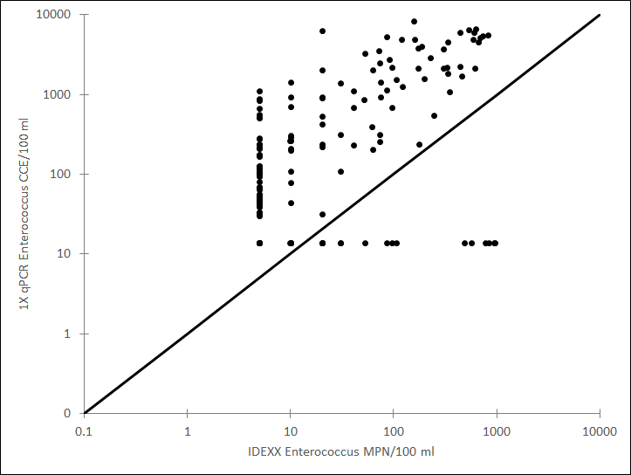
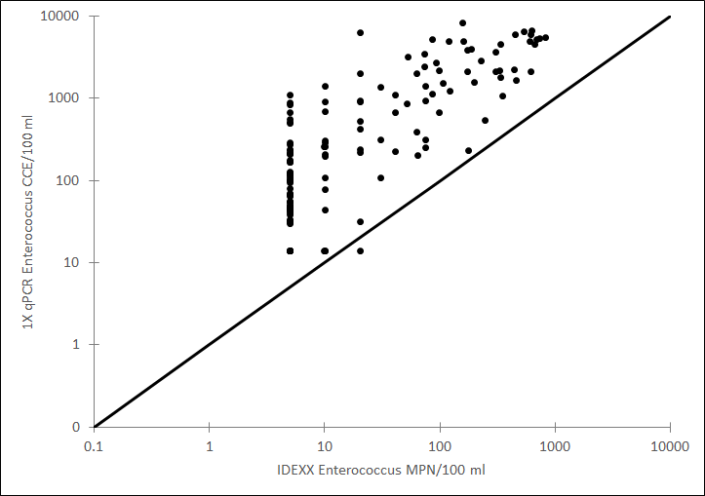
Correlation between IDEXX and qPCR detection
Figure 12. Comparison of Enterococcus concentrations detected by IDEXX and 1X qPCR in 6 independent samples (n=162) from each site using Spearman rank correlations, Rs = 0.51, P < 0.001.
Solid line represents a 1:1 relationship.
Figure 13. Comparison of Enterococcus concentrations detected by IDEXX and 1X qPCR in 6 independent samples (n=144) per site with QC fails removed using Spearman rank correlations, Rs = 0.79, P < 0.001.
Solid line represents a 1:1 relationship.
Notes:
This slide shows two figures. The figure on the left is a comparison of Enterococcus concentrations detected by IDEXX and 1X qPCR in 6 independent samples (n=162) from each site using Spearman rank correlations, Rs = 0.51, P < 0.001. Solid line represents a 1:1 relationship.
The figure on the right is a comparison of Enterococcus concentrations detected by IDEXX and 1X qPCR in 6 independent samples (n=144) per site with QC fails removed using Spearman rank correlations, Rs = 0.79, P < 0.001. Solid line represents a 1:1 relationship.

Slide 15
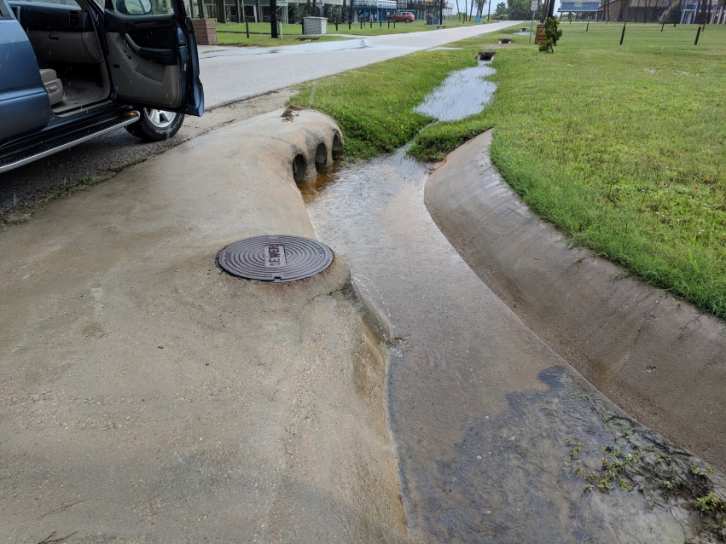
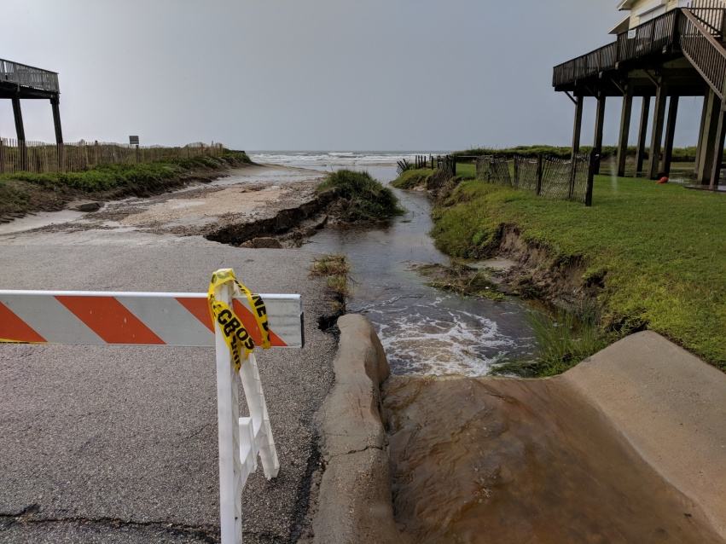
Cohen’s Kappa values for IDEXX/qPCR comparison
Sample grouping | Cohen's k
6 samples per site | 0.60 ± 0.05
6 samples per site, no QC fails | 0.68 ± 0.04
Table 7. Cohen’s k values for detection of Enterococcus and 1X qPCR at 27 collection sites with standard error indicated.
Notes:
This table shows the Cohen’s κ values for detection of Enterococcus and 1X qPCR at 27 collection sites with standard error indicated.
Agreement between the two methods is moderate if 0.41 ≤κ≤0.60, substantial if 0.61 ≤κ≤ 0.80, and almost perfect if κ > 80.0. Values of κ for the data indicate moderate agreement with qPCR QC fail samples included, and they indicate substantial agreement with qPCR QC fail samples removed.

Slide 16
PCR Inhibition vs. PCR Interference
PCR inhibition: decreased DNA detection due to inhibition of DNA polymerase
Forward primer
Reverse primer
DNA Polymerase
Fluorescent Probe
PCR interference: decreased DNA detection due to factors other than DNA polymerase inhibition
Forward primer
Reverse primer
DNA Polymerase
Fluorescent Probe
Notes:
PCR inhibition or PCR interference can decrease or prevent amplification of DNA sequences.
PCR inhibition is a decrease of DNA amplification due to an inhibition of the DNA polymerase enzyme to function at optimal capacity. The decrease in enzyme function can be partial or complete.
PCR interference is a decrease in the detection of a DNA target in a PCR reaction due to reasons outside of DNA polymerase inhibition. The decrease in DNA target detection can be partial or complete.
The purple triangles above show potential targets of inhibition and interference.

Slide 17

qPCR Quality Control Measures for
Detection of QC problems
Every qPCR reaction had an internal amplification control to detect qPCR inhibition
  A piece of synthetic DNA at known concentration for detection/quantitation
Every DNA extraction had salmon sperm DNA added to it for detection of qPCR interference
  A second qPCR reaction detected/quantified the salmon DNA to assess extraction yield and ability to amplify the DNA
Notes:
This slide explains some of the quality control measures used to detect quality control problems in qPCR.

Slide 18
Number of qPCR QC failures for each site-sampling event combination
Notes:
This figure shows the number of qPCR QC failures for each site-sampling event combination. The x-axis shows the site-sampling event combinations. The y-axis shows the number of QC fails. The blue bars represent IDEXX, red represents 1x dilution qPCR, and green represents 5x dilution qPCR.

Slide 19
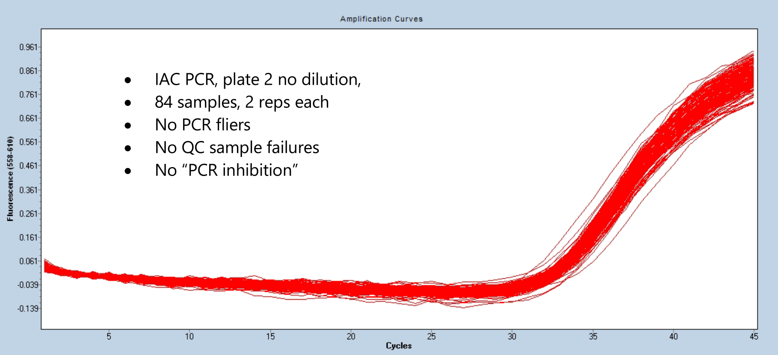
Control Measures
  Internal Amplification Control (IAC)
    Monitors reaction for PCR inhibition
84 samples, 2 reps/sample
IAC amplification curves
No QC fails, no PCR inhibition
Notes:
This graph is an example of the Internal amplification curve. This curve is used to monitor reactions exhibiting PCR inhibition.
This is a graph showing 84 samples from sampling event 2 and most importantly, no PCR inhibition. If PCR inhibition had occurred, the amplification curves from inhibited samples would have shifted to the right.

Slide 20
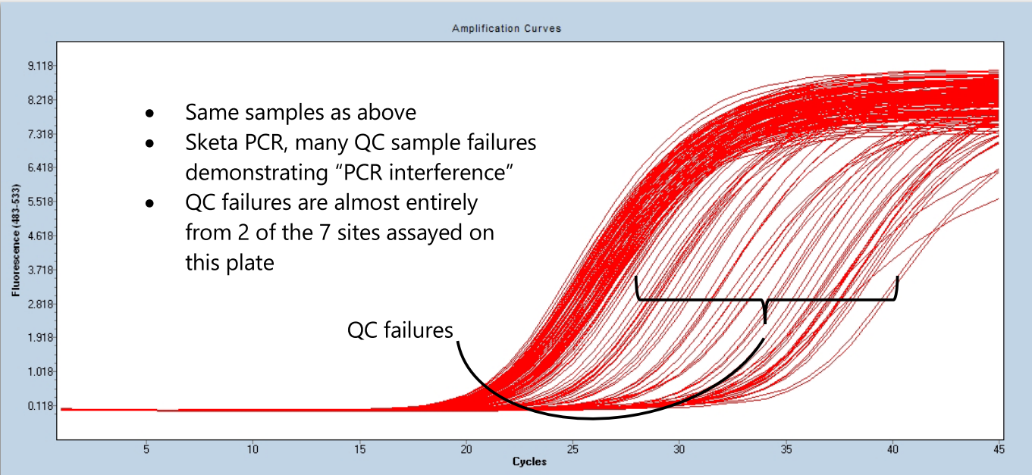
Control Measures
  Salmon Sperm DNA
    Monitors the yield of DNA following extraction and PCR interference
84 samples, 2 reps/sample
Salmon sperm PCR, many QC sample failures demonstrating “PCR interference”
QC failures
Notes:
This image is Salmon Sperm DNA amplification curves. This graph is from the most interfered plate, mainly comprised of samples from a single sampling event.
Most samples here cross a threshold of measurable fluorescence (known as a cycle threshold or CT) at around 20-21 cycles.
All of these right-shifted curves are exhibiting delayed amplification due to presumed nucleases in the samples, distinguishable by CT values upwards of 25.
This is a dramatic representation of what PCR interference looks like in graphical form.
The higher the CT values indicate the most PCR interference relative to other samples with lower CT values.

Slide 21
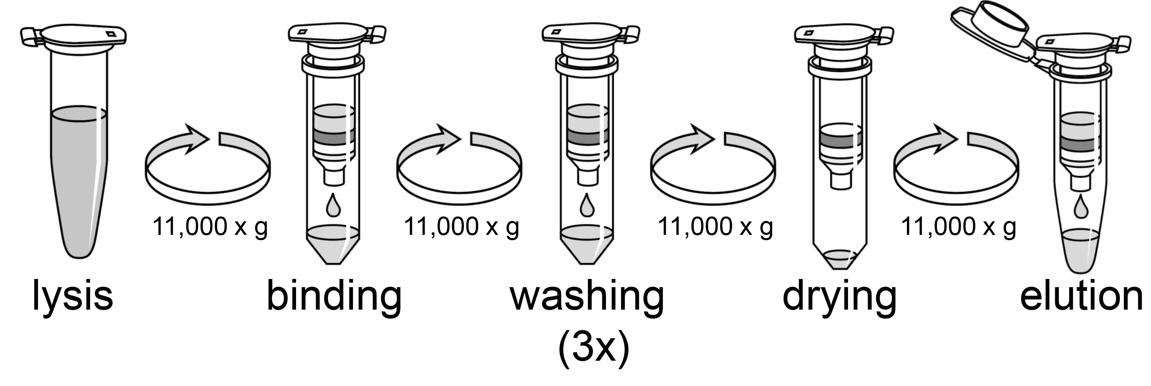
DNA Extractions (EPA 1609.1)
100 mL of each water sample was filtered through a 0.45 μm filter
Cells were lysed using glass beads
Cell debris was collected by centrifugation
lysis
transfer (2x)
Notes:
Samples were filtered following the same parameters from Environmental Protection Agency (EPA) Method 1609.1. The method uses a crude cell lysate as the DNA extraction that is tested by qPCR. Thus, many contaminants are also placed into the qPCR reaction along with DNA.

Slide 22
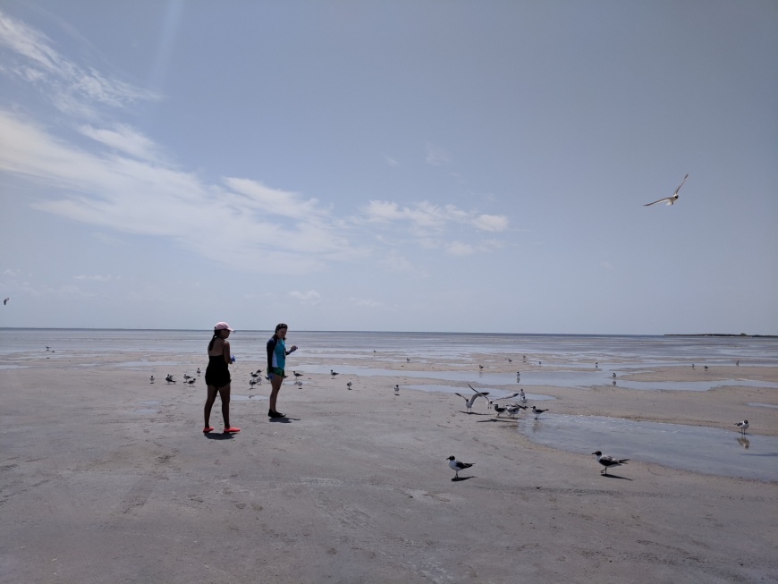
Hypotheses about qPCR interference
Interference samples may have greater amounts of nuclease activity than samples free from interference.
Microbial taxa in samples that display PCR interference may have notable differences in microbial alpha or beta diversity indicating potential sources of PCR interference.
Functional differences may exist between PCR interference samples and interference-free samples.
Notes:
This slide shows three hypotheses about why qPCR interference may have occurred in these samples.

Slide 23

SUMMARY
Statistical comparisons of Enterococcus detection by IDEXX and qPCR in Texas marine waters suggest that the two methods largely agree.
Detection by qPCR may decrease assay time from ~ 24 hours to ~ 6 hours.
qPCR detection cost is > 3X IDEXX cost.
  Method 1609.1 for qPCR detection of Enterococcus requires greater technical skill than the culture-based Enterolert method.
No qPCR inhibition was detected in any sample.
qPCR interference was present in ~ 10% of samples and can prevent detection of threshold exceedances.
qPCR interference is likely due to high DNase concentration or activity in some samples.
An additional sample heating step may decrease or eliminate DNase activity when using qPCR method 1609.1.

Slide 24

Other Contributors to the Project
Dr. Larry Hauck, TIAER
Stephanie Brady, TIAER
James Hunter, TIAER
Katie Maryak, Texas A&M AgriLife
Bianca Serrano, Texas A&M AgriLife
Kate Lavelle, TCEQ
Joe Martin, TCEQ
Tarleton State University College of Science and Technology Student Research Funding
Notes:
List of contributors to the project.

Slide 25

Questions?

Slide 26
Station IDs and Descriptions
SWQM Station ID | Station Description | GLO Beach Name, GLO Station ID, GLO Beach ID | General Conditions
14561 | Upper Galveston Bay at Sylvan Beach Park near Laporte | Sylvan Beach Park HAR002; TX412536 | Inner bay location close to urban populations with high level of advisories
16539 | Gulf of Mexico at end of Jolly Roger Road 240 m south and 203 m east of its intersection with FM 3005 on Galveston Island | Jamaica Beach GAL014; TX974690 | Open ocean
22115 | Gulf of Mexico near Quintana Texas 310 meters south and 167 meters east of the intersection of 8th Street and Burnet Street | Quintana (8th Street) BRA004; TX728060 | Open ocean site near Freeport Harbor Channel and in proximity of the Brazos River entering the Gulf of Mexico
22112 | Corpus Christi Bay at Cole Park 101 meters east of the intersection of Oleander Avenue and Ocean Drive | Cole Park NUE031; TX259476 | Inner bay with urban runoff impacts
20958 | Corpus Christi Bay at Ropes Park 108 meters north and 44 meters east from the intersection of Ropes Street and Ocean Drive | Ropes Park NUE028; TX821303 | Inner bay with urban runoff impacts
22113 | Gulf of Mexico At Padre Bali Park 517 meters east and 219 meters south of the intersection of South Padre Island Drive and Park Road 5 Beach Entrance | Padre Bali Park NUE022; TX314643 | Open ocean
22114 | Gulf of Mexico at JP Luby Park 866 meters east and 606 meters south of the intersection of SH 361 and Zahn Road | JP Luby Park NUE016; TX607336 | Open ocean near Packery Channel inlet to Corpus Christi Bay
22116 | Laguna Madre near Sargent Beach 589 meters west and 209 meters north of Orca Circle and Padre Blvd | Park Road 100 Bay Access #2 CAM029; TX229010 | Bay side, near WWTF outfall
22117 | Gulf of Mexico at Isla Blanca Park 475 meters east and 60 meters north of the intersection Of Park Road 100 and Gulf Side Loop | Isla Blanca Park CAM008; TX714667 | Open ocean near WWTF outfall
Notes:
Table showing SWQM station ID, station description, GLO Beach name and GLO station ID, and the general conditions of the site.

