Slide 1
UPDATES ON 30 TAC CHAPTER 217
DESIGN CRITERIA FOR
WASTEWATER SYSTEMS

Slide 2
History of Major Changes of the Wastewater Treatment Design Criteria in Texas
First consolidated design criteria adopted by Texas State Department of Health on 9/18/1950.
This document was revised on:
9/11/1961 9/18/1968
9/13/1970 9/01/1974
6/01/1981 4/20/1990
8/28/2008 12/04/2015

Slide 3
Chapter 217 Update Timeline
Kick-off Meeting
Due-date for comments/proposed changes
Draft Memo with proposed changes
Start revisions and meet with stakeholders on sections of the Design Criteria
Draft rules to the commission for permission to publish in the Texas Register
Public Hearing on draft rules
Adoption of updated rules
November 2020
November 15, 2020
February 2021
November 2021- April 2022
August 2022
September 2022
February 2023

Slide 4
Chapter 217 Update - Probable Changes
Emergency Power for Critical Components
Collection System Updates
Primary Clarifiers
Aeration Basins
Sequencing Batch Reactor (SBR)
Membrane Bio Reactor (MBR)
Nutrient Removal Systems
Natural System
Disinfection Requirements
New Subchapter I

Slide 5

Emergency Power for Critical Components
Wastewater response to Senate Bill 3 (SB-3 Emergency Preparedness)
Strengthening rules for Back-up power for Critical Treatment Units
Critical Treatment Units
  Dependent of treatment system
  Aeration (partial or full)
  Disinfection
  Pumping – no unauthorized discharges
  Keep flow moving – avoid septic conditions
Notes:
Photo in slide – no attribution needed (https://pixabay.com/illustrations/electricity-power-power-bank-2314633/)

Slide 6

Collection System Updates
Piping Updates
  New piping technologies
  Review of force mains pressure requirements
Lift Station
  Active volume
  Emergency storage
Editorial corrections throughout collection system Subchapter
Engineers must justify designs for nonstandard subdivisions
Notes:
Photo in slide – no attribution needed (https://pixabay.com/illustrations/conveyor-water-pipes-flange-water-5438409/)

Slide 7
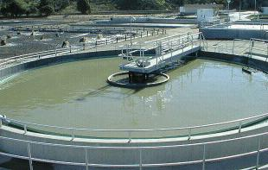
Primary Clarifiers
Weir loading rates
  Dependent on
    Use of primary clarifier (treatment, or equalization)
    Size of clarifier
    Treatment following clarifiers
Peak flow usage
Concern with flooding the weirs
  possibly require double weir

Slide 8
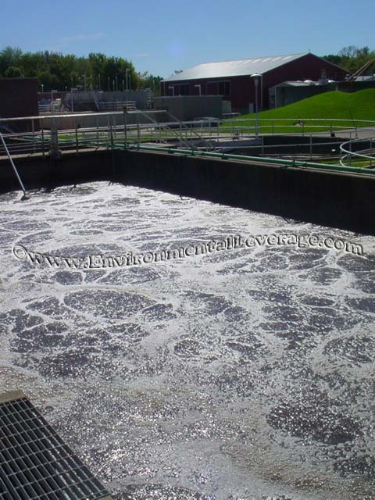

Aeration Basins
Aeration Basins
  Updating loading criteria
  Verbiage corrections
  Possible aeration piping updates
  Reviewing diffuser correction factors and depths
Ensure that our Equations are accurate for currently loading
  Higher influent nitrogen (N)
  Higher influent phosphorus (P)

Slide 9
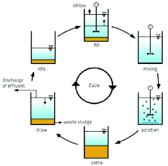
Sequencing Batch Reactors (SBRs) and Membrane Bioreactor (MBR)
Sequencing Batch Reactors (SBRs)
  Peak flow usage
  Decanter design - Average design flow (ADF) vs Peak design flow (PDF)
  Basin sizing (ADF vs PDF)
Membrane Bioreactor (MBR)
  Membrane types and technologies
  Peak flow usage
  Flux rates at ADF and PDF
  Design standards

Slide 10
Advanced Nutrient Removal
Reason for Update:
  Permits now having additional limits
    Total Nitrogen
    Total Phosphorus
Strengthening the design requirements in Section 217.63 Advanced Nutrient Removal

Slide 11
Natural Systems Probable Changes
Align Section of 217.203 to agree with 30 TAC 309.13(d)
  Impoundments overlying recharge zones of major or minor aquifers
    require soil lines of 3 ft. thickness
    require 10⁻⁷ permeability
    minimum 40mm thickness for synthetic liner
Remove ambiguities / contradictions – Texas vs. Other States
Other updates as needed, will be determined during review

Slide 12
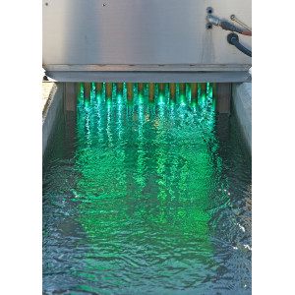
Updating Disinfection Requirements
Updating Subchapter K: Chlorine Disinfection Requirements
    Gaseous Chlorine
    Sodium Hypochlorite
    Peracetic Acid (PAA)
Updating Subchapter L: UV Disinfection Requirements
    Update UV Rules
    Look into redundancy requirements
    Look into regrowth issues
    Look at Bioassay requirements

Slide 13
Subchapter I
Moving Chapter 222 Subchapter D into 30 TAC 217 Subchapter I
Adding treatment and disposal methods to this subchapter that are inline with both state and federal requirements
Addition of pressure dosing
Reviewing the existing design criteria for this subchapter to see if they need to be updated

